Slide 1
ES6 Key Concepts : Arrow
React Course

Slide 2
Arrow function specific
Anonymous
A shorter syntax
The number of parameters in an arrow function affects the syntax of that function
It depends what return
Lexical binding
Performance hits

Slide 3
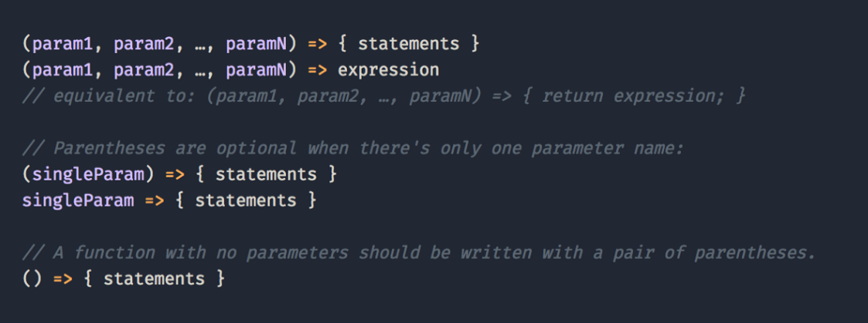
Arrow function syntax
The syntax of the arrow function consists of zero or more parameters, an arrow => and then concludes with the function statements.

Slide 4
Arrow function parameters
If there are 0 Parameters, arrow functions use empty parenthesis:
() => { statements }
If there is 1 Parameter, arrow functions can omit the parenthesis around the parameter:
parameter => { statements }
If there are 2+ Parameters, parameters go inside parenthesis:
(param1, param2, ...) => { statements }

Slide 5
Return or not return: what the question
If an arrow function is simply returning a single line of code, you can omit the statement brackets and the return keyword. This tells the arrow function to return the statement. Implicit return, only if there is no block.
If several lines and no return that arrow as every function returns undefined unless otherwise specified. Means you have to write return.
If we’re not returning anything so there is no shortcut for the statement

Slide 6
Parentheses for implicit return
When writing a functional component in React, you can use parentheses to wrap implicitly returned JSX
const FunctionalComponent = () => (
<div>
<OtherComponent />
</div>
);

Slide 7


Arrow exercises

Slide 8
Question: is compiled? if yes what returns?
((name) => {})()
((name) => 'Hi ' + name)('Jess’)
((name) => {'Hi ' + name})('Jess’)
((name) => {return 'Hi ' + name})('Jess’)
((name) => {id: name})('Jess’)
((name) => ({id: name}))('Jess’)
((name) => {return {id: name}})('Jess')

Slide 9
Got the answers
 | Call | Output | Why
1 | ((name) => {})() | undefined | an empty block with an implicit return
2 | ((name) => 'Hi ' + name)('Jess') | 'Hi Jess' | no block means implicit return
3 | ((name) => {'Hi ' + name})('Jess') | undefined | explicit return required inside block, but is missing
4 | ((name) => {return 'Hi ' + name})('Jess') | 'Hi Jess' | explicit return in block exists
5 | ((name) => {id: name})('Jess') | undefined | a block containing a single label. No explicit return.
6 | ((name) => ({id: name}))('Jess') | {id: 'Jess'} | implicit return of expression ( ) which evaluates to an object
7 | ((name) => {return {id: name}})('Jess') | {id: 'Jess'} | explicit return inside block returns object

Slide 10

This and functions

Slide 11
Classic functions
With classic function ‘this’, always references the owner of the function it is in
Function defined its own this - meaning we were required to explicitly bind or locally store the this
Hard binding applied to get proper THIS in needed context - top-level this followed by a .bind(this)
this.editRow = this.editRow.bind(this);

Slide 12
Arrow functions and this
Lexical Scoping
It uses this from the code that contains the Arrow Function.
they inherit the one from the parent scope
Arrow functions do not bind their own this

Slide 13
When better function / arrow function
if you want this to be the calling context you should not use the arrow function.
Arrow functions do not work with the super keyword when you try to override the function in a child class.

Slide 14


Performance tricks

Slide 15
Performance
Usual functions are defined in the prototype and will be shared across all instances.
If we have a list of N components, these components will share the same method.
This allows us to have optimized execution
Arrow functions defined amon class properties
if we’re creating N components, these N components will also create N functions. Which means if we click on N components, N different functions will be called.

Slide 16
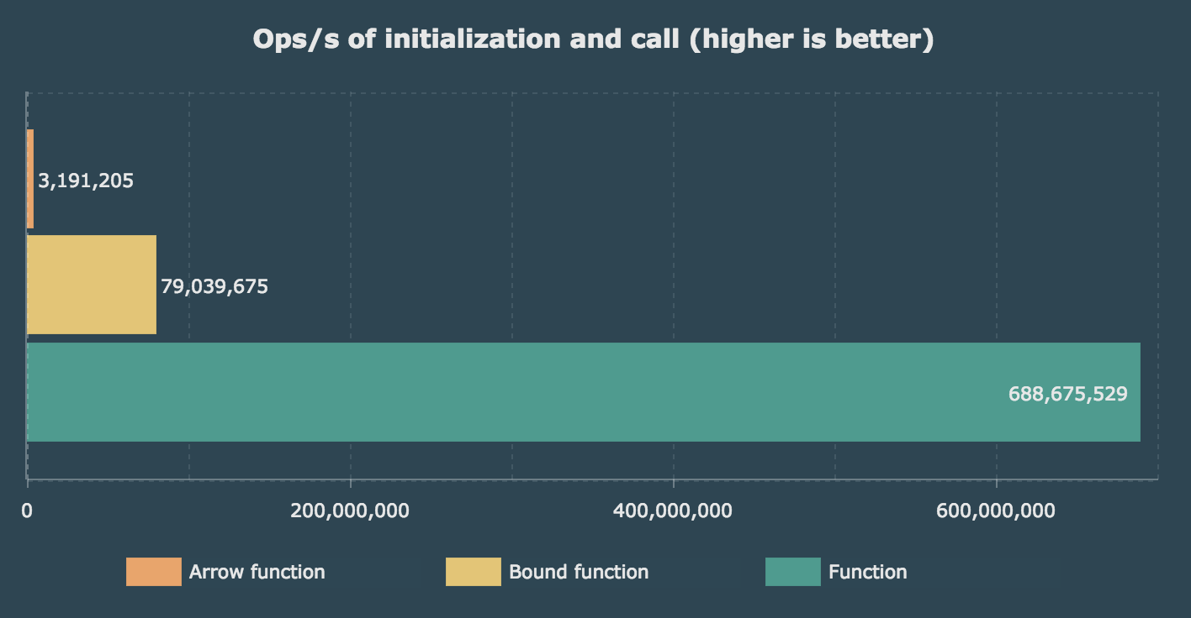
V8 Benchmarks
https://medium.com/@charpeni/arrow-functions-in-class-properties-might-not-be-as-great-as-we-think-3b3551c440b1

